Slide 1
Smart system
Arduino based smart home system

Slide 2
Project introduction
Reuse of household appliance is and forming a smart system is important part of IoT (internet of things). As there are enormous of household appliances that are thrown away just for a simple upgrade. I think it is very important for us to track and reuse the product to minimize the electronic waste(e-waste). Which can achieved by simple upgrade to the present product. This research proposal addresses the lack of suitable compact devices that can be used to upgrade the present appliances into smart appliances. I will develop an old machine into smart machine by adding a simple add on to a device. Which will make any pre existing devices as heater and fans to a smarty system being able to detect the temperature and people in the house and maintain temperature in an efficient way.

Slide 3
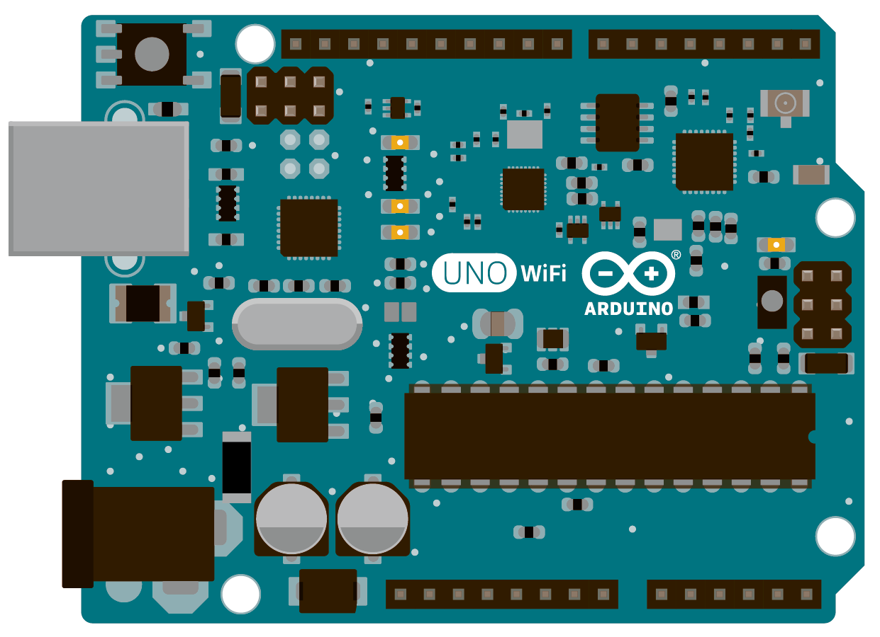
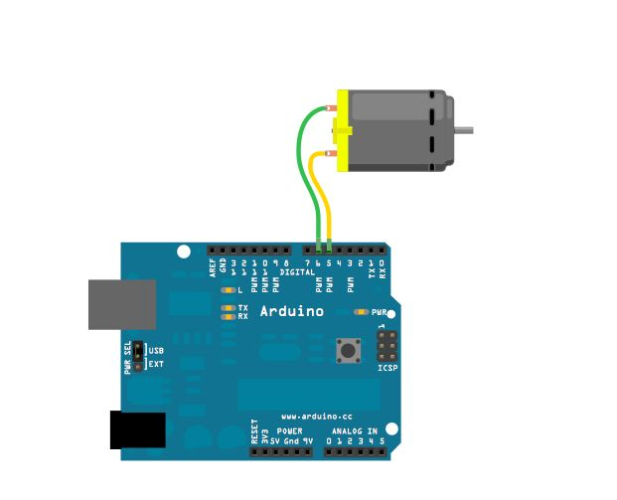
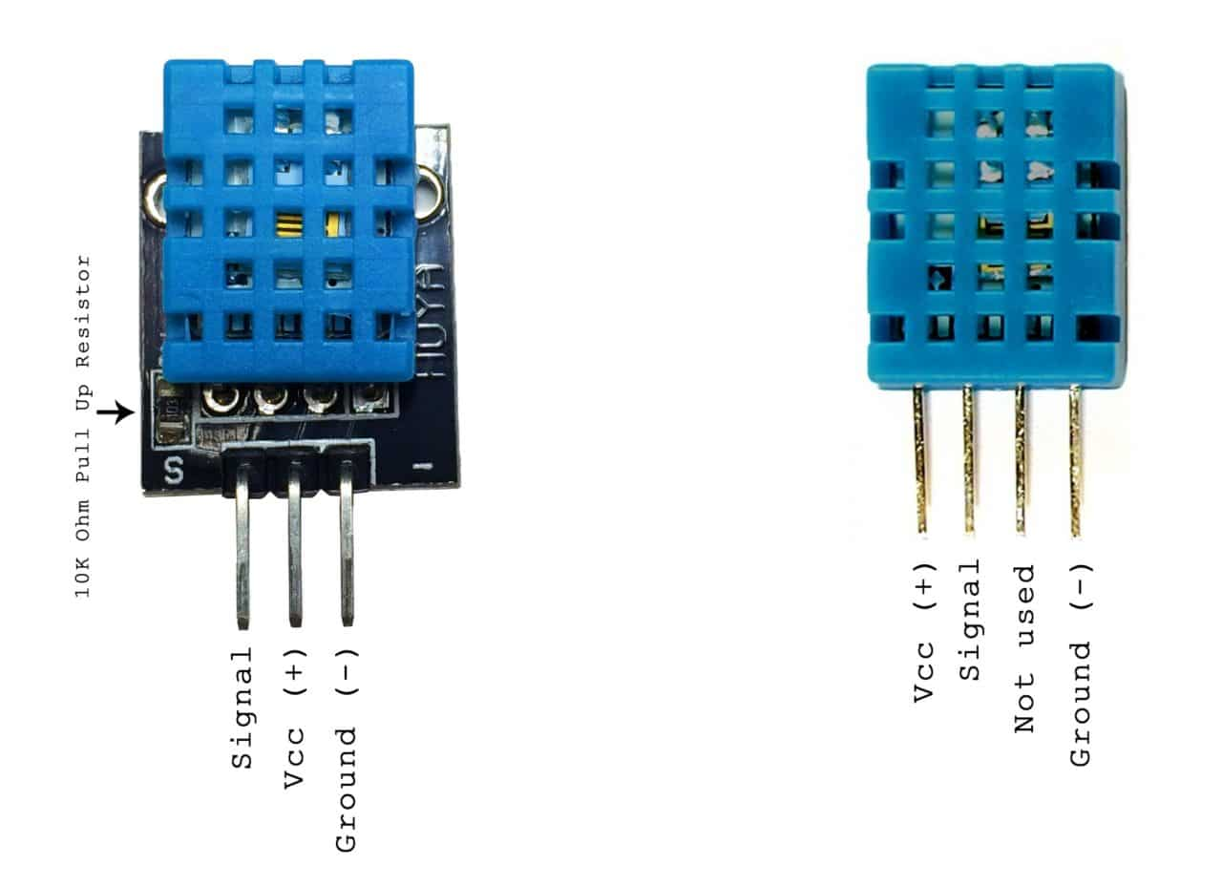
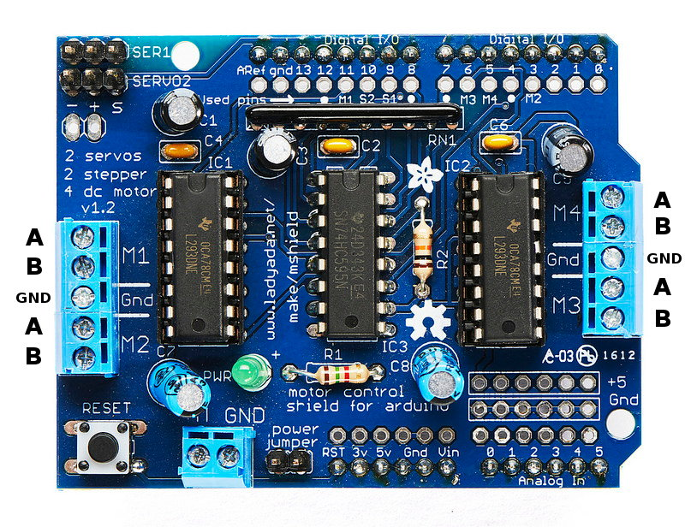
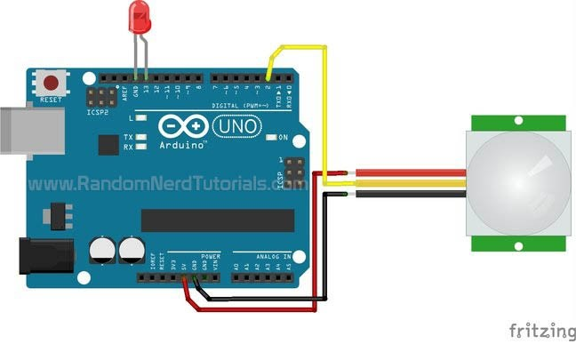
Hardware requirements
Here the most important thing that is required for the development of this project is Arduino and some other sensors mentioned below.
1. Arduino uno
2. Jumper wires
3. data logger shield
4. motor shield
5. temperature sensor
5. motion sensor
6.wire cable

Slide 4
Software requirements
Some of the software that are used to develop and show this project are as follows:
1. Arduino IDE
2. tablue
3. Microsoft powerpoint

Slide 5
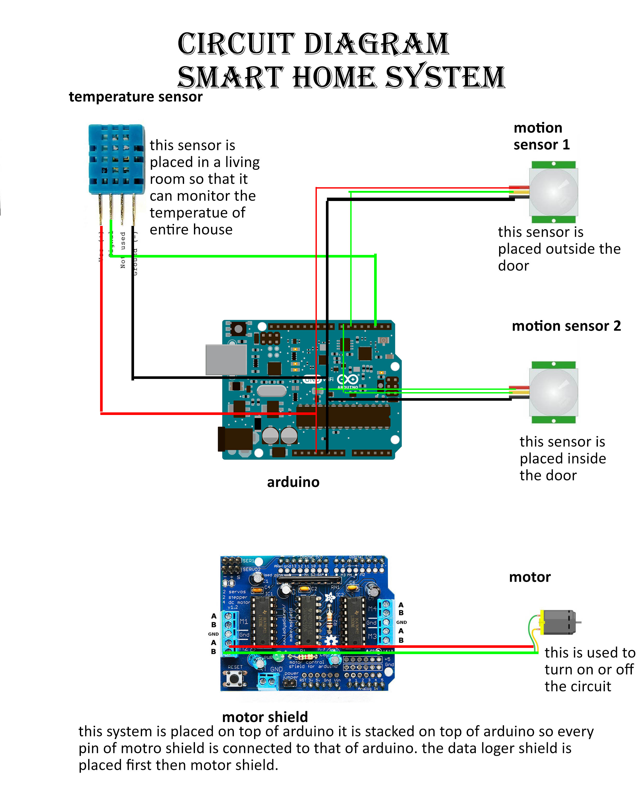
Circuit diagram
Here is the circuit diagram of the smart home system which gives us detailed information about how the connection is made.
Black lines represent negative (ground)
Red represents positive (5v vcc)
And yellow represent data

Slide 6
Functions and features
To maintain temperature.
Re utilizing the e-waste materials
Cheap alternative to smart house system
Small and easily installable
Low cost
Energy efficient

Slide 7
Future scope
Adding other devices and interconnecting the entire house
Remote access to the house
Monitoring activities with in the house.

Slide 8
Group members
Peeyoosh Bajracharya (group leader) (lead Programmer)
Ashish Manchanda (hardware)
Oliver Benidictt (---------------------)
John Amgad (data visualizer)

